Slide 1
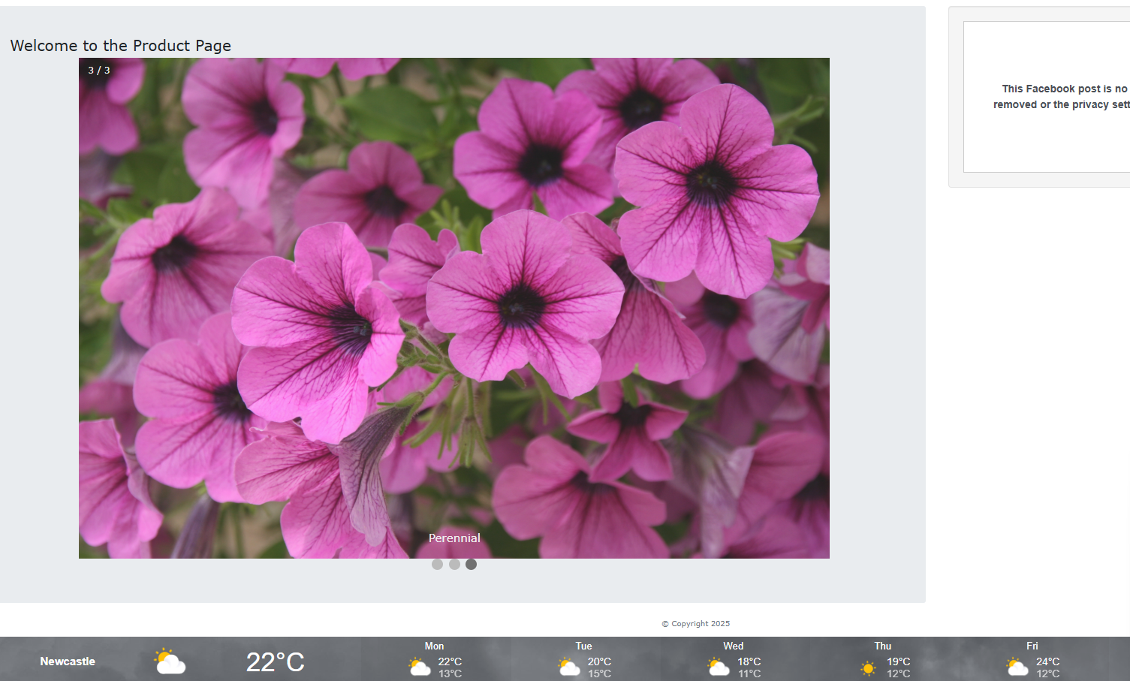
We are going to create the following.
Today session is the following:
A). Build a template
B.) Call external CSS script
C.) Make a navigation system
D). Make an animated slider
E). Import API from a Weather Server
F). Bring in a Facebook post

Slide 2
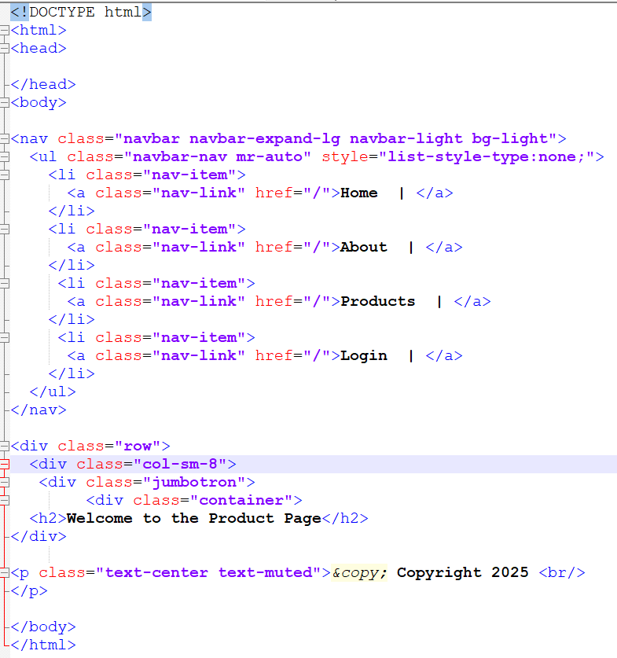
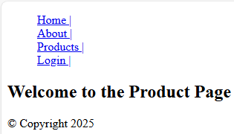
Step 1: create the following template.
<!DOCTYPE html>
<html>
<head>
</head>
<body>
<nav class="navbar navbar-expand-lg navbar-light bg-light">
<ul class="navbar-nav mr-auto" style="list-style-type:none;">
<li class="nav-item">
<a class="nav-link" href="/">Home | </a>
</li>
<li class="nav-item">
<a class="nav-link" href="/">About | </a>
</li>
<li class="nav-item">
<a class="nav-link" href="/">Products | </a>
</li>
<li class="nav-item">
<a class="nav-link" href="/">Login | </a>
</li>
</ul>
</nav>
<div class="row">
<div class="col-sm-8">
<div class="jumbotron">
<div class="container">
<h2>Welcome to the Product Page</h2>
</div>
<p class="text-center text-muted">&copy; Copyright 2025 <br/>
</p>
</body>
</html>

Slide 3
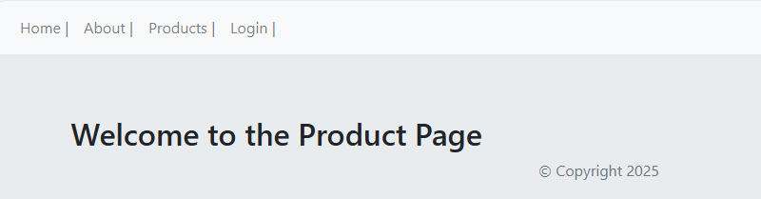
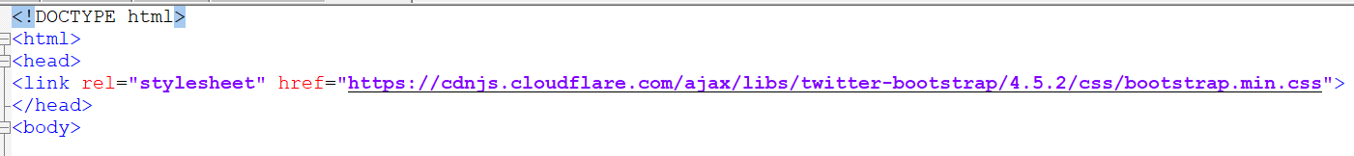
Step 2: Add the following Script to <head> </head>
<!DOCTYPE html>
<html>
<head>
</head>
<body>
<nav class="navbar navbar-expand-lg navbar-light bg-light">
<ul class="navbar-nav mr-auto" style="list-style-type:none;">
<li class="nav-item">
<a class="nav-link" href="/">Home | </a>
</li>
<li class="nav-item">
<a class="nav-link" href="/">About | </a>
</li>
<li class="nav-item">
<a class="nav-link" href="/">Products | </a>
</li>
<li class="nav-item">
<a class="nav-link" href="/">Login | </a>
</li>
</ul>
</nav>
<div class="row">
<div class="col-sm-8">
<div class="jumbotron">
<div class="container">
<h2>Welcome to the Product Page</h2>
</div>
<p class="text-center text-muted">&copy; Copyright 2025 <br/>
</p>
</body>
</html>
<link rel="stylesheet" href="https://cdnjs.cloudflare.com/ajax/libs/twitter-bootstrap/4.5.2/css/bootstrap.min.css">
We are directly calling the CSS script cloudflare.com, as similar to an API call and
Use their predefined values.

Slide 4
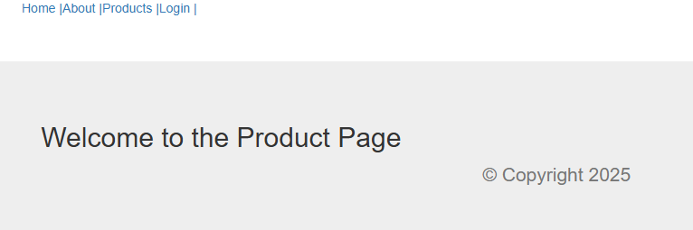
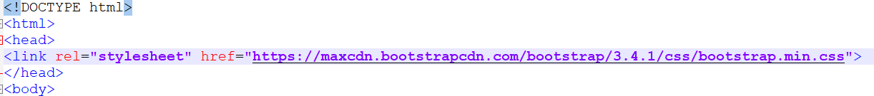
Step 3: Modify the following Script to <head> </head>
<!DOCTYPE html>
<html>
<head>
</head>
<body>
<nav class="navbar navbar-expand-lg navbar-light bg-light">
<ul class="navbar-nav mr-auto" style="list-style-type:none;">
<li class="nav-item">
<a class="nav-link" href="/">Home | </a>
</li>
<li class="nav-item">
<a class="nav-link" href="/">About | </a>
</li>
<li class="nav-item">
<a class="nav-link" href="/">Products | </a>
</li>
<li class="nav-item">
<a class="nav-link" href="/">Login | </a>
</li>
</ul>
</nav>
<div class="row">
<div class="col-sm-8">
<div class="jumbotron">
<div class="container">
<h2>Welcome to the Product Page</h2>
</div>
<p class="text-center text-muted">&copy; Copyright 2025 <br/>
</p>
</body>
</html>
<link rel="stylesheet" href="https://maxcdn.bootstrapcdn.com/bootstrap/3.4.1/css/bootstrap.min.css">
We are directly calling the CSS script from maxcdn, as similar to an API call and
Use their predefined values.
Notice the navigation style has changed, and slight positioning.

Slide 5
Step 3: Modify the following Script to <head> </head>
<!DOCTYPE html>
<html>
<head>
</head>
<body>
<nav class="navbar navbar-expand-lg navbar-light bg-light">
<ul class="navbar-nav mr-auto" style="list-style-type:none;">
<li class="nav-item">
<a class="nav-link" href="/">Home | </a>
</li>
<li class="nav-item">
<a class="nav-link" href="/">About | </a>
</li>
<li class="nav-item">
<a class="nav-link" href="/">Products | </a>
</li>
<li class="nav-item">
<a class="nav-link" href="/">Login | </a>
</li>
</ul>
</nav>
<div class="row">
<div class="col-sm-8">
<div class="jumbotron">
<div class="container">
<h2>Welcome to the Product Page</h2>
</div>
<p class="text-center text-muted">&copy; Copyright 2025 <br/>
</p>
</body>
</html>
<link rel="stylesheet" href="https://maxcdn.bootstrapcdn.com/bootstrap/3.4.1/css/bootstrap.min.css">
We are directly calling the CSS script from maxcdn, as similar to an API call and
Use their predefined values.
Notice the navigation style has changed, and slight positioning.

Slide 6
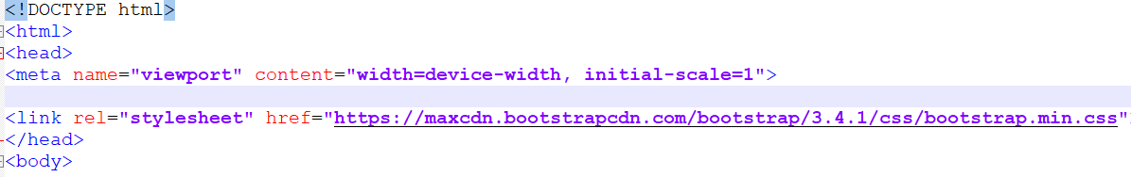
Step 4: Modify the following Script to <head> </head>
<!DOCTYPE html>
<html>
<head>
</head>
<body>
<nav class="navbar navbar-expand-lg navbar-light bg-light">
<ul class="navbar-nav mr-auto" style="list-style-type:none;">
<li class="nav-item">
<a class="nav-link" href="/">Home | </a>
</li>
<li class="nav-item">
<a class="nav-link" href="/">About | </a>
</li>
<li class="nav-item">
<a class="nav-link" href="/">Products | </a>
</li>
<li class="nav-item">
<a class="nav-link" href="/">Login | </a>
</li>
</ul>
</nav>
<div class="row">
<div class="col-sm-8">
<div class="jumbotron">
<div class="container">
<h2>Welcome to the Product Page</h2>
</div>
<p class="text-center text-muted">&copy; Copyright 2025 <br/>
</p>
</body>
</html>
<link rel="stylesheet" href="https://maxcdn.bootstrapcdn.com/bootstrap/3.4.1/css/bootstrap.min.css">
We are directly calling the CSS script from maxcdn, as similar to an API call and
Use their predefined values. But this time, we have added in <meta name=“viewport”>
This enables the page scale to different devices.

Slide 7
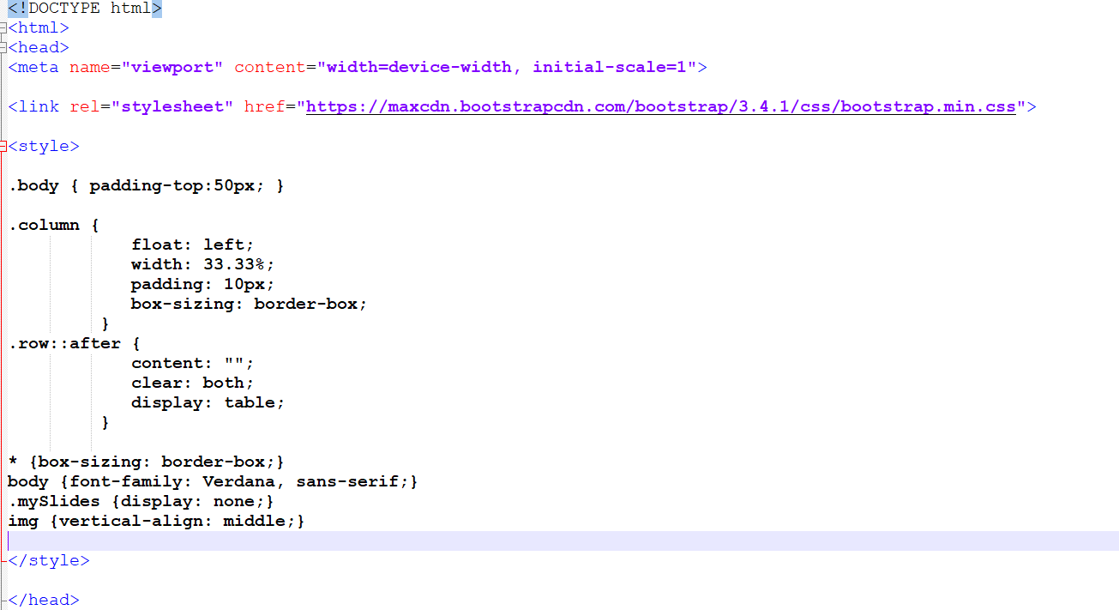
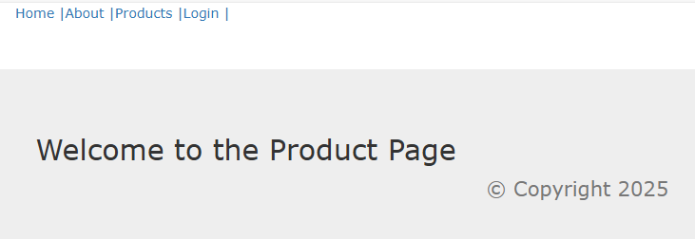
Step 5: Add the following Script to <head> </head>
<style>
.body { padding-top:50px; }
.column {
float: left;
width: 33.33%;
padding: 10px;
box-sizing: border-box;
}
.row::after {
content: "";
clear: both;
display: table;
}
* {box-sizing: border-box;}
body {font-family: Verdana, sans-serif;}
.mySlides {display: none;}
img {vertical-align: middle;}
</style>
We are going to add in the Style Sheet, extra padding, column, rows, and font-type

Slide 8
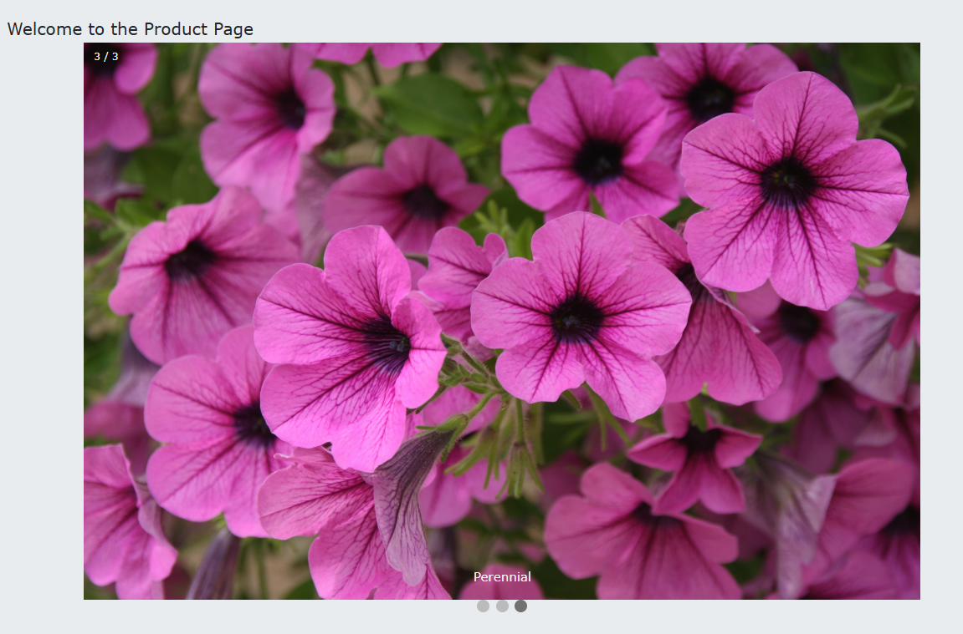
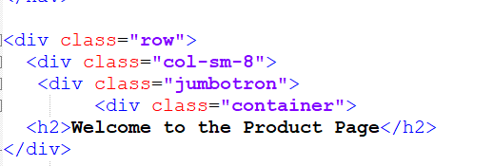
Step 6: Leave the <Head> </Head> section for now
<div class="slideshow-container">
<div class="mySlides fade">
<div class="numbertext">1 / 3</div>
<img src="https://th.bing.com/th/id/R.50a981ee04dc2ad8f330c169ec9ef323?rik=mCvu77fdho%2fSoA&riu=ht tp%3a%2f%2f2.bp.blogspot.com%2f- 2qxPkXyBmdc%2fUx1UkeU81DI%2fAAAAAAAAGSw%2fqamul8YINuc%2fs1600%2fplumeria-19- frangipani_flower_2-top-10-best-beautiful-spectacular-world-wallpaper- free.jpg&ehk=Kni6J8dpWuoOvhw9A0bQIBJA9MGfI9UxlrIrv3CmUJY%3d&risl=&pid=ImgRaw&r=0" style="width:100%">
<div class="text">Orchids</div>
</div>
<div class="mySlides fade">
<div class="numbertext">2 / 3</div>
<img src="https://th.bing.com/th/id/OIP.tT5AULZcbHhyxZw1qATXHAHaE8?pid=ImgDet&rs=1"
style="width:100%">
<div class="text">Annual Flowers</div>
</div>
<div class="mySlides fade">
<div class="numbertext">3 / 3</div>
<img src="https://www.loveyourlandscape.org/media/83247/istock-172290812.jpg"
style="width:100%">
<div class="text">Perennial</div>
</div>
</div>
<div style="text-align:center">
<span class="dot"></span>
<span class="dot"></span>
<span class="dot"></span>
</div>
</div>
</div>
Under the </div> tag, we will add the following script:

Slide 9
Step 7: Back to the style sheet add the full style sheet:
<style>
.body { padding-top:50px; }
.column {
float: left;
width: 33.33%;
padding: 10px;
box-sizing: border-box;
}
.row::after {
content: "";
clear: both;
display: table;
}
* {box-sizing: border-box;}
body {font-family: Verdana, sans-serif;}
.mySlides {display: none;}
img {vertical-align: middle;}
/* Slideshow container */
.slideshow-container {
max-width: 1000px;
position: relative;
margin: auto;
}
/* Caption text */
.text {
color: #f2f2f2;
font-size: 15px;
padding: 8px 12px;
position: absolute;
bottom: 8px;
width: 100%;
text-align: center;
}
/* Number text (1/3 etc) */
.numbertext {
color: #f2f2f2;
font-size: 12px;
padding: 8px 12px;
position: absolute;
top: 0;
}
/* The dots/bullets/indicators */
.dot {
height: 15px;
width: 15px;
margin: 0 2px;
background-color: #bbb;
border-radius: 50%;
display: inline-block;
transition: background-color 0.6s ease;
}
.active {
background-color: #717171;
}
/* Fading animation */
.fade {
animation-name: fade;
animation-duration: 1.5s;
}
@keyframes fade {
from {opacity: .4}
to {opacity: 1}
}
/* On smaller screens, decrease text size */
@media only screen and (max-width: 300px) {
.text {font-size: 11px}
}
</style>

Slide 10
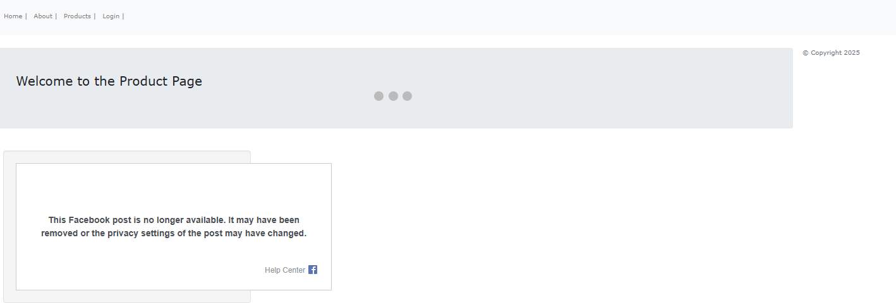
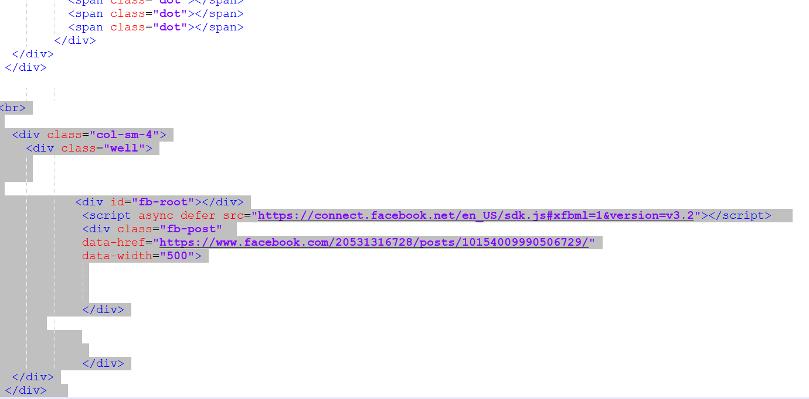
Step 8: Back to the style sheet add the full style sheet:
<br>
<div class="col-sm-4">
<div class="well">
<div id="fb-root"></div>
<script async defer src="https://connect.facebook.net/en_US/sdk.js#xfbml=1&version=v3.2"></script>
<div class="fb-post"
data-href="https://www.facebook.com/20531316728/posts/10154009990506729/"
data-width="500">
</div>
</div>
</div>
</div>
Add the script below the last div (3rd one from
The <span> </span>).

Slide 11
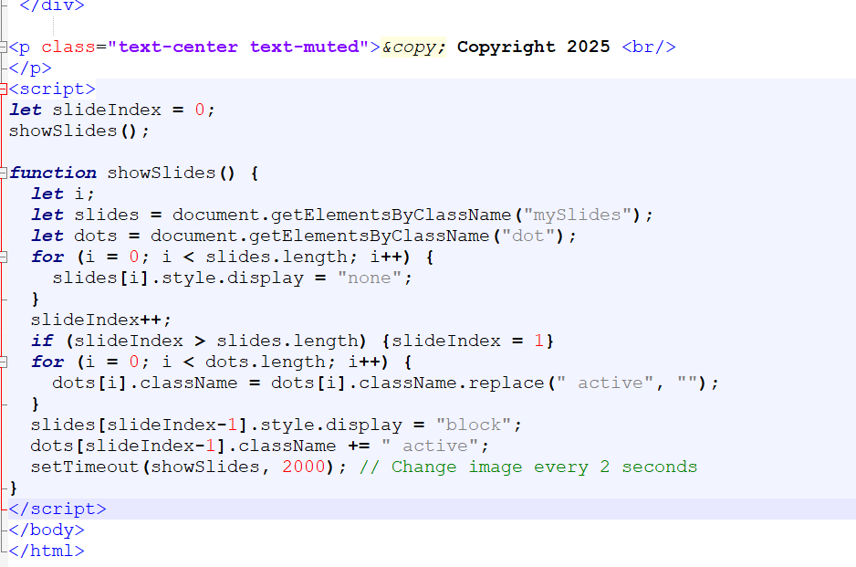
Step 9: Add in the JavaScript to make it all work ☺
Add the script between the </p> and above the </body>

Slide 12
Step 10: JavaScript
<script>
let slideIndex = 0;
showSlides();
function showSlides() {
let i;
let slides = document.getElementsByClassName("mySlides");
let dots = document.getElementsByClassName("dot");
for (i = 0; i < slides.length; i++) {
slides[i].style.display = "none";
}
slideIndex++;
if (slideIndex > slides.length) {slideIndex = 1}
for (i = 0; i < dots.length; i++) {
dots[i].className = dots[i].className.replace(" active", "");
}
slides[slideIndex-1].style.display = "block";
dots[slideIndex-1].className += " active";
setTimeout(showSlides, 2000); // Change image every 2 seconds
}

Slide 13
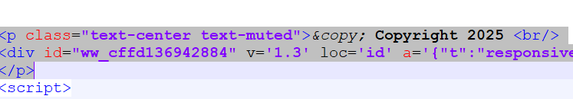
Step 11: Final Step – add in API to the weather station
Add the API call inbetween the <p> <br/> and </p>
<p class="text-center text-muted">&copy; Copyright 2025 <br/>
<div id="ww_cffd136942884" v='1.3' loc='id' a='{"t":"responsive","lang":"en","sl_lpl":1,"ids":["wl752"],"font":"Arial","sl_ics":"one_a","sl_sot":"celsius","cl_bkg":"image","cl_font":"#FFFFFF","cl_cloud":"#FFFFFF","cl_persp":"#81D4FA","cl_sun":"#FFC107","cl_moon":"#FFC107","cl_thund":"#FF5722"}'>More forecasts: <a href="https://oneweather.org/london/30_days/" id="ww_cffd136942884_u" target="_blank">30 day weather forecast London</a></div><script async src="https://app3.weatherwidget.org/js/?id=ww_cffd136942884"></script>
</p>

Slide 14
Add in the additional links within the <head>
<html>
<head>
<meta name="viewport" content="width=device-width, initial-scale=1">
<!-- Latest compiled and minified CSS -->
<link rel="stylesheet" href="https://maxcdn.bootstrapcdn.com/bootstrap/3.4.1/css/bootstrap.min.css">
<!-- jQuery library -->
<script src="https://ajax.googleapis.com/ajax/libs/jquery/3.7.1/jquery.min.js"></script>
<!-- Latest compiled JavaScript -->
<script src="https://maxcdn.bootstrapcdn.com/bootstrap/3.4.1/js/bootstrap.min.js"></script>
<!-- CSS (load bootstrap from a CDN) -->
<link rel="stylesheet" href="https://cdnjs.cloudflare.com/ajax/libs/twitter-bootstrap/4.5.2/css/bootstrap.min.css">
<style>

